Slide 1

HR Analytics -Employee Retention
Kavita Joshi
Sunanda Jakani
BHAVYA C P
AMRUTHA M S
Shruti Vinod Shukla p.Ashwin Kumar
TEAM 1

Slide 2


Project overview
Project Name: Employee Retention
Domain: HR Analytics
Dataset Name: HR_1 & HR_2
Objective/ Challenge: Reducing the Very high Attrition of Organization
Dataset Type: Excel Data
Dataset Size: 50k records each
Dashboard Visualisation is done through – MS-Excel, Tableau, MYSQL, PowerBI

Slide 3



Observations and suggestions of kpi’s
Attrition
Average Hourly rate of Male Research Scientist
Attrition rate Vs Monthly income stats
Average working years for each Department
Job Role Vs Work life balance
Attrition rate Vs Year since last promotion relation
50.21%
Permissible level -<10%
115(both male and female)
26000 vs 8 %
20.50
2.5
1-10 – 41% -20718
Observations’
Very High attrition
Overall the female attrition rate is higher than the male
Active employees form 49%
Department wise-Attrition for Research & Development is highest – Female attrition rate is higher than the male
The probable reason for high attrition in R & D may be the average income being less compared to other departments and many more. Let’s explore…

Slide 4



OBSERVATIONS – KPI 1
Subject of Comparison | Least | Maximum
Attrition vs Job Satisfaction | R & D | NA
Attrition vs Job Involvement | HR | NA
Attrition vs Environment Satisfaction | R & D | NA
Attrition vs Hourly Rate | R & D | NA
Attrition vs Job Satisfaction vs Job Role | Hardware - Sales Executive, HR - Research Director, R & D – Developer, Sales – Lab Technician, Sales Executive, Software – HR, Support - HR | NA
Attrition vs Business Travel | NA | Non-Travel - R & D, Travel Frequently – HR, Travel Rarely – Software
Attrition vs Daily Rate | Software
Attrition vs Distance From Home(Average) | NA | Support
Average of Monthly Rate | R & D
Over Time | NA | R & D
Percent Salary Hike | Skewed hikes across the organization i.e. Average <=2%, ideally should follow Bell Curve. The deviation is on the higher side. 0- 15 -31%, 16-32- 33%,33-49-32%..
Total Working Years | 24 years – 126 – Hardware, Human Resources – 25 years- 126, Research & Development – 1 year – 128, Sales -2,3,4,6,8.9.11---Approx700

Slide 5


Observations –(Example for inequity )
40937 | 859677 | 5 | Y | No | 48 | 3 | 1 | 80 | 1 | 34 | 2 | 3 | 12 | 4 | 1 | 10
40831 | 1061606 | 3 | Y | No | 3 | 4 | 3 | 80 | 1 | 39 | 2 | 3 | 17 | 14 | 7 | 16
14164 | 311608 | 8 | Y | Yes | 43 | 4 | 1 | 80 | 1 | 35 | 5 | 3 | 24 | 24 | 4 | 23
Inequity
Lower Productivity
Absenteeism
Attrition
Leads to
Observations - KPI 6
Dissonance/no-correlation with Year since last promotion relation with years in the company
41% of attrition to the set of employees who have 1 to 10, Years since the last promotion range.

Slide 6

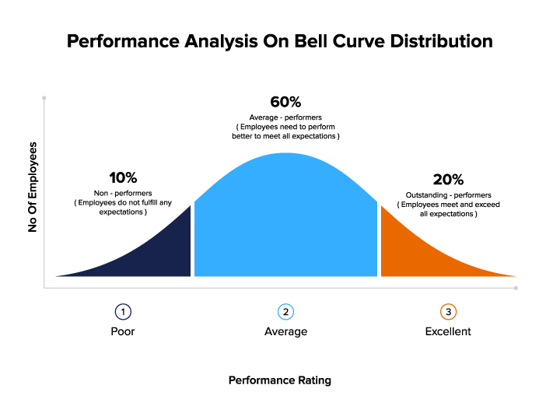
Observations AS - Swot analysis
Strength
Employee’s
Weakness
Attrition
Threat
Loss that is irreversible
Opportunity
Employee engagement
Employee experience
Brand loss
Retention strategy’s
Employees
Revision
Retention
Re- Hire
3R- Approach

Slide 7





Suggestions – Next Steps
Employee Engagement Programs
Strategies for Retention
Professional Development
Opportunities
Flexible Work Arrangements
Competitive Compensation and Benefits
Implementing Change
- Communicate the plan to the entire organization
- Assign responsibilities to relevant teams or individuals
Monitoring and Feedback
- Establish a system for ongoing employee feedback
- Regularly assess the effectiveness of retention strategies
Above Organizational Interventions lead to slackening attrition

Slide 8
KPI - 2
AVERAGE HOURLY RATE OF Male RESEARCH SCIENTIST

Slide 9
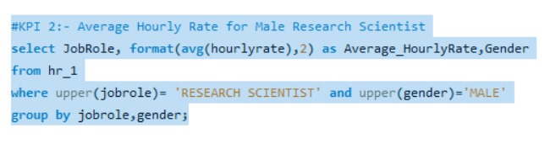
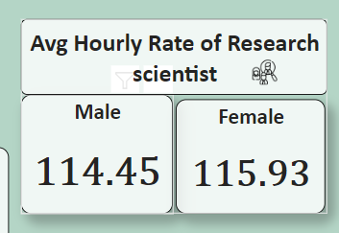
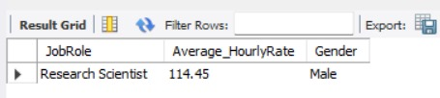
Data Visualization
Average hourly rate means the rate used in calculating premium pay. This rate is determined by taking the average of earnings including wage rate, and shift premium for all hours worked in the payroll week.

Slide 10
OBSERVATIONS:
Among 50,000 number of employees 25059 are males and 24941 are females.
As compared to the department ,the laboratory technician it is found that males have the average hourly rate of 117.201.
SUGGESTIONS:
On considering new skills or certifications relevant to the field, gaining more experience, showcasing a strong portfolio, negotiating effectively, and targeting higher-paying clients or projects and by improving efficiency and productivity can contribute to higher earnings and can increase average hourly rate.
By increasing average income, focusing on career development with regular Performance appraisals and assured raise, continuous upskilling by regular training and development programs- which enhances the motivation and increases the hygiene factors of the organization . Overall , it will improves the average rate automatically.

Slide 11
CONCLUSIONS:
This rate signifies the average compensation received per hour by male research scientists in the dataset.
The average hourly rate of research scientist males is calculated as $114.45.

Slide 12
KPI -3
ATTRITION RATE VS MONTHLY INCOME STATS

Slide 13
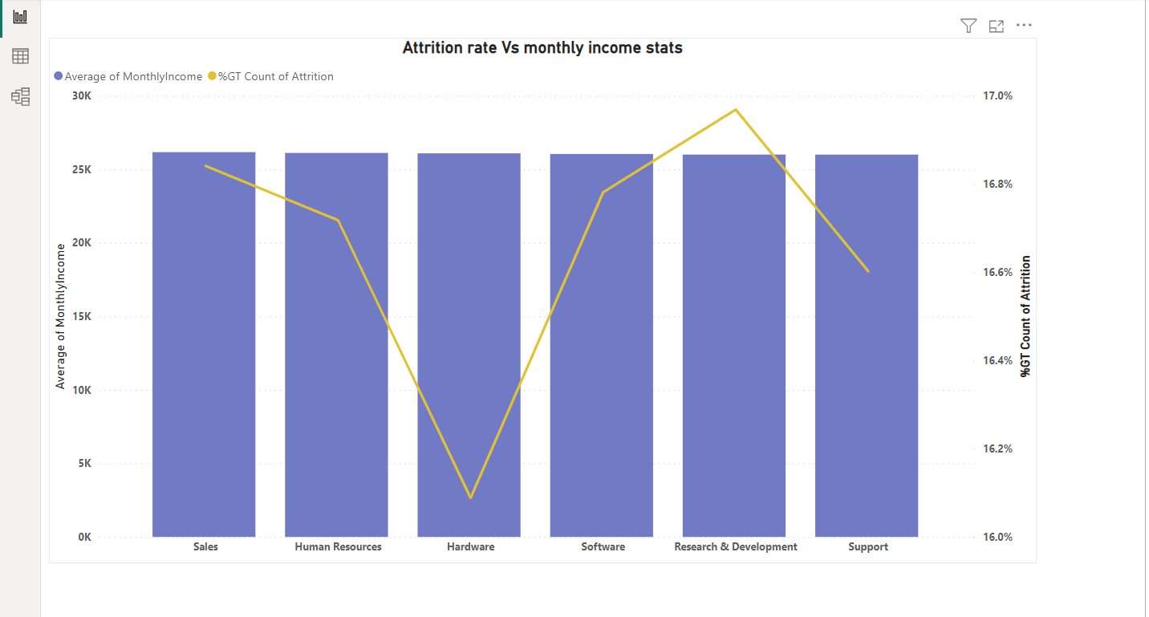
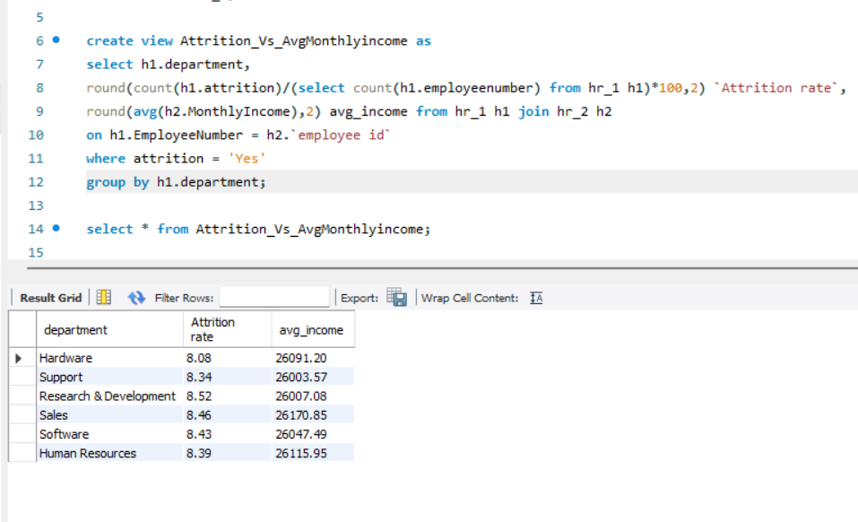
Data Visualization using different tools:

Slide 14
OBSERVATIONS:
The attrition rates across departments seem relatively close, hovering around 8.08% to 8.52%. The highest attrition rate belongs to the Research & Development department at 8.52%, while Hardware stands with the lowest at 8.08%
There's minimal disparity in attrition rates among these departments.
The average monthly income varies slightly across departments, with values ranging from 26000 to 26170.
SUGGESTIONS:
Explore non-income-related factors impacting attrition, such as job satisfaction or growth opportunities.
Investigate the reasons behind slight disparity in avg monthly incomes among department , assessing whether if affects job satisfaction and employee retention.
Collect feedback through exit interviews or surveys to comprehend the reasons behind employees leaving.
Provide opportunity for career growth and development to motivate employees to stay.

Slide 15
CONCLUSIONS :
Attrition rates appear consistent across departments, suggesting other factors beyond income drive employee turnover.
While income is a factor, it doesn't seem to singularly drive attrition in these departments.
To gain deeper insights, investigating qualitative aspects like workplace environment or career development prospects might offer more insights into reducing attrition rates and improve employee retention.

Slide 16
KPI - 4
Average working years for each Department

Slide 17
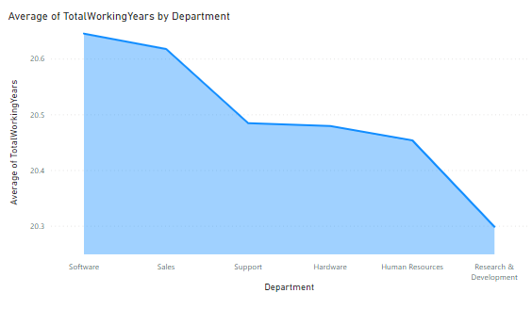
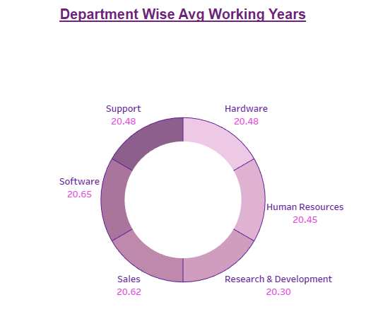
Highest
Lowest
Max
Min

Slide 18
OBSERVATIONS:
The Avg Working Years for each Department wise Ranges from 20.30 to 20.65.
The Software is the Department with highest Avg Working Years at 20.65 where as Research and Development is the Department with lowest Avg Working Years at 20.30.
SUGGESTIONS:
Conducting Exit Interviews, Focus more on Research and Development Department as they have lowest Avg Working Years.
Improving Employee Engagement activities in the Company.
Figure out the other factors which are leading more Attrition rate and take necessary actions to over come from it.

Slide 19
CONCLUSION:
Software and Sales Departments have Great Working Years.
Support, Hardware and Human Resources have Good Working Years.
Research and Development Department have Poor Working Years.
Though the R & D’s average working years is less across the organization, the retention policies weren’t enforced to a make better workforce. Hence very stringent and focussed employee-centric policies are needed to churn the cream/talent.

Slide 20
KPI -5
JOB Role vs Work life balance

Slide 21
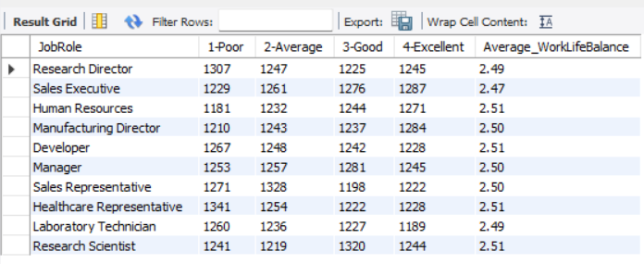
OVERVIEW:
The data provided presents the average Work-Life Balance ratings across various job roles within the organization.
The average Work-Life Balance ratings range from 2.47 to 2.51, with most job roles clustered around 2.50.
OBSERVATIONS:
HR is having poor work life balance.
Employees from HR department are not getting promotion frequently and they are getting less monthly income.
Lowest Value
Poor Work-Life Balance
Highest Value

Slide 22
SUGGESTIONS:
To present the average Work-Life Balance ratings for each job role and discuss the significance of work-life balance for employee well-being and organizational success.
Explain how a healthy work-life balance contributes to employee satisfaction, engagement, productivity.
Collect employee feedback to understand their work-life balance with respect to job.
Provide career growth, medication, events to motivate employees.
CONCLUSIONS :
Research directors , Human resources ,Developers, laboratory technicians and Healthcare representatives have the work life balance is poor.
The Sales representatives and Sales executives have the work life balance is average.
Research Scientists and Managers have the work life balance is good.
Sales executives, Manufacturing Directors , Laboratory technicians have the work life balance is excellent.

Slide 23

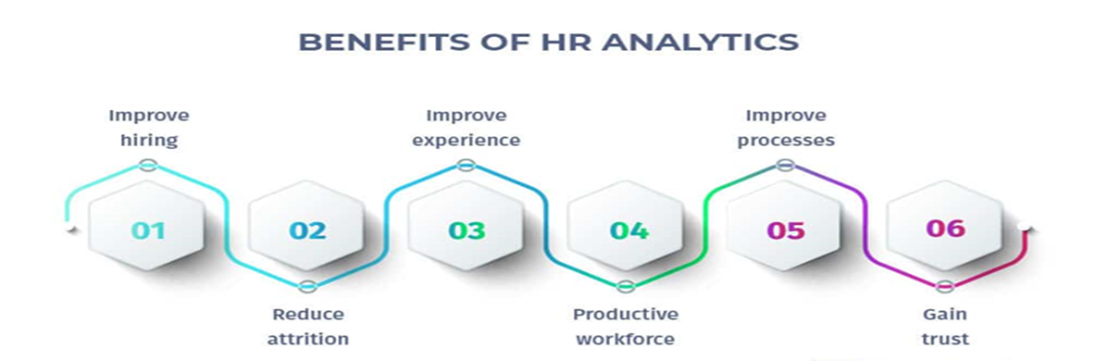

FINAL Conclusion
Improving workplace culture
Addressing employee concerns
Providing growth opportunities and recognizing achievements
Conduct exit interviews and use feedback to make positive changes
Implementing mentorship programs, offering competitive benefits, and fostering work-life balance
Regularly assess and adjust your strategies based on employee feedback and industry trends
Attrition
Mantra for higher productivity
Productivity

Slide 24






Thank You

